Slide 1
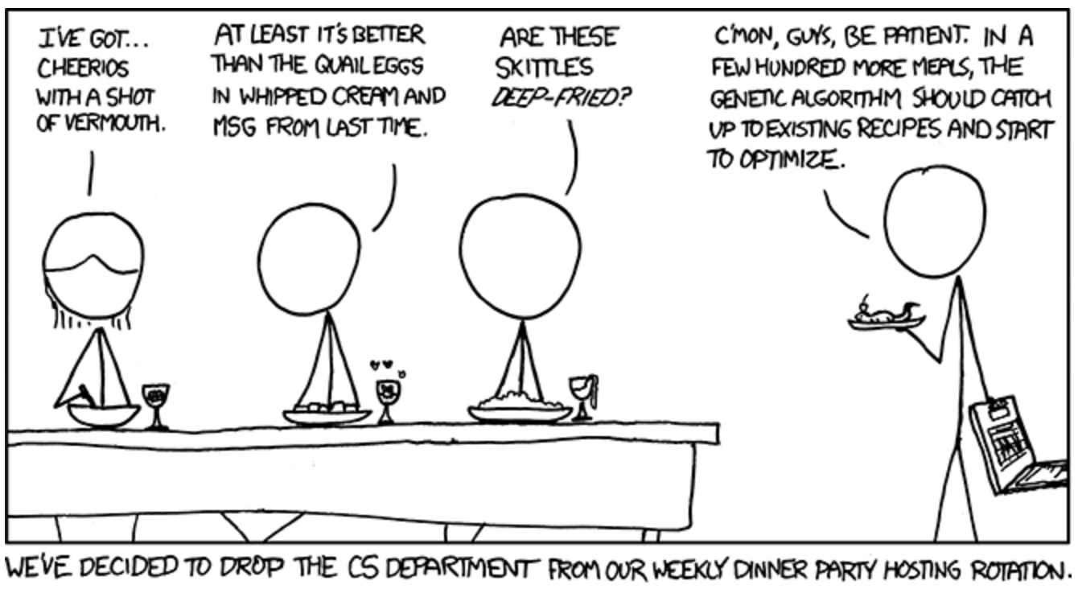
Exploration of Black Box Optimization Tools
https://xkcd.com/720/

Slide 2

Bayesian Optimization “Bayes_Opt”
This is a constrained global optimization package built upon Bayesian inference and Gaussian process.
Constrained global optimization - process of optimizing an objective function with respect to some variables in the presence of constraints on those variables
It attempts to find the maximum or minimum value of an unknown function in as few iterations as possible.
This is particularly useful for optimization of high-cost functions or situations where the balance between exploration and exploitation is important.
Example: Drilling for oil, testing each location may cost $1 million or more

Slide 3
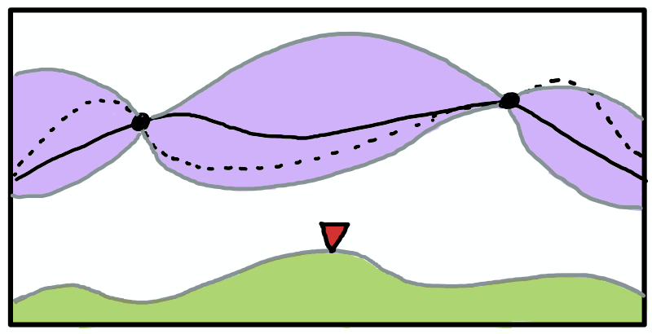


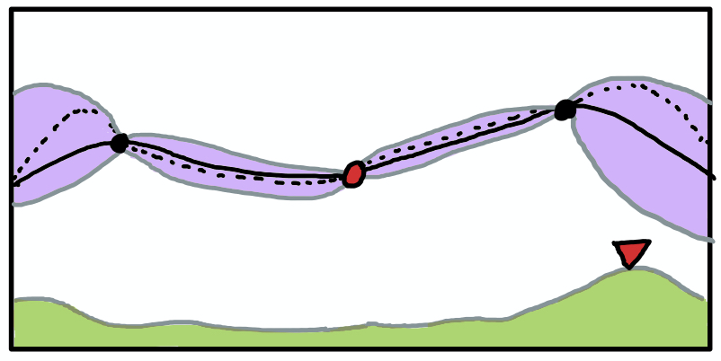
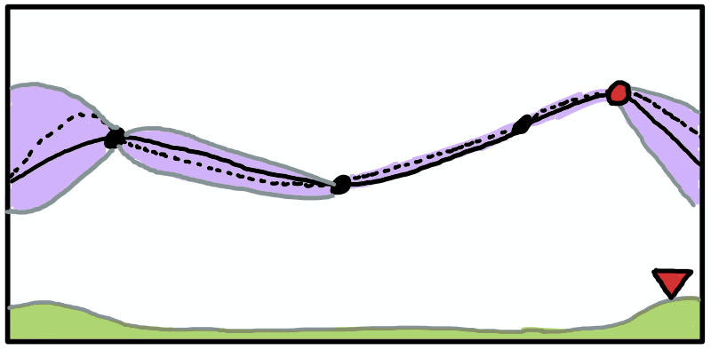
Posterior mean
Posterior mean +/- std dev
Acquisition function
True objective
Acquisition Max
Bayesian optimization works by constructing a posterior distribution of functions via Gaussian Process (posterior mean) that best describes the function you want to optimize (true objective).
As the number of observations grows, the posterior distribution improves, and the algorithm becomes more certain of which regions in parameter space are worth exploring and which are not.
An acquisition function is used to balance between exploration and exploitation.

Slide 4
Bayes_Opt:
1. for t = 1, 2… do
2. Find x_{t} by combining attributes of the posterior distribution in a utility (acquisition) function u and maximizing:
3. Sample the objective function:
y_{t} = f(x_{t}) = ɛ_{t}
4. Augment the data D_{1:t} = {D_{1:t-1}, (x_{t}, y_{t})}
5. end for

